Slide 1
Walmart Sales Forecasting and Optimization

Slide 2
Overview
This project develops a machine learning system to forecast weekly sales for Walmart stores across 45 locations and 99 departments. The goal is to predict future sales using historical data, store characteristics, external factors, and promotional activities.

Slide 3
Milestone 1: Data Preprocessing & Feature Engineering
In this milestone, our main goal was to transform raw historical Walmart data into a clean, rich, feature-engineered dataset that is ready for forecasting.
Stage 1 forms the foundation for all later modeling and analysis.

Slide 4
Milestone 1: Overview of Stage 1
Data Loading & Cleaning
Exploratory Data Analysis
Feature Engineering
Final Dataset Generation

Slide 5
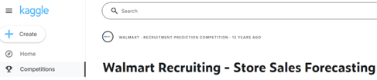

Milestone 1: Raw Data Inputs
Our input data included historical weekly sales, store information, and external factors such as CPI, fuel price, and markdown promotions. The challenge was merging all this information into a unified structure.
train.csv (421,570 rows)
test.csv (115,064 rows)
features.xlsx
stores.csv
Temperture
Fuel Price
Markdown
Type
Size

Slide 6
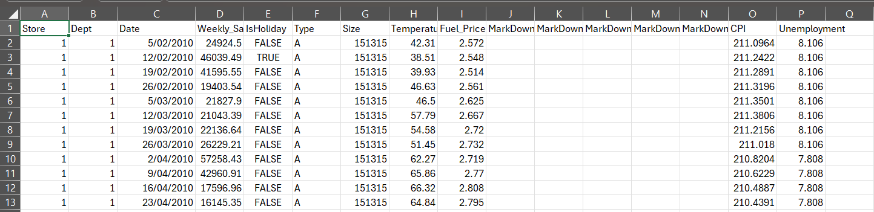
Step 1.1: Data Loading & Merging
In Step 1.1, we merged all datasets into consolidated training and test files. This step ensured that every sales record now includes the corresponding store information and external features.
After merging, we had 16 columns in training data and 15 in test data.

Slide 7
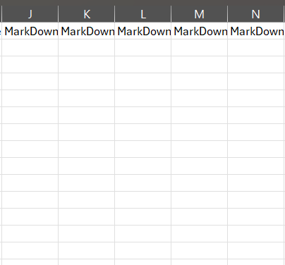
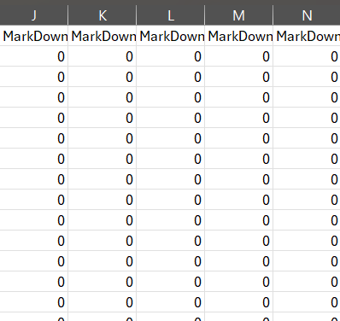
Step 1.2: Handling Missing Values
Markdown columns had high missing percentages—up to 74%. Instead of dropping them, we filled missing values with 0 and created binary indicator features to signal whether a markdown existed. This not only kept the data but also enriched it. By the end of this step, we achieved 100% completeness with zero missing values.

Slide 8
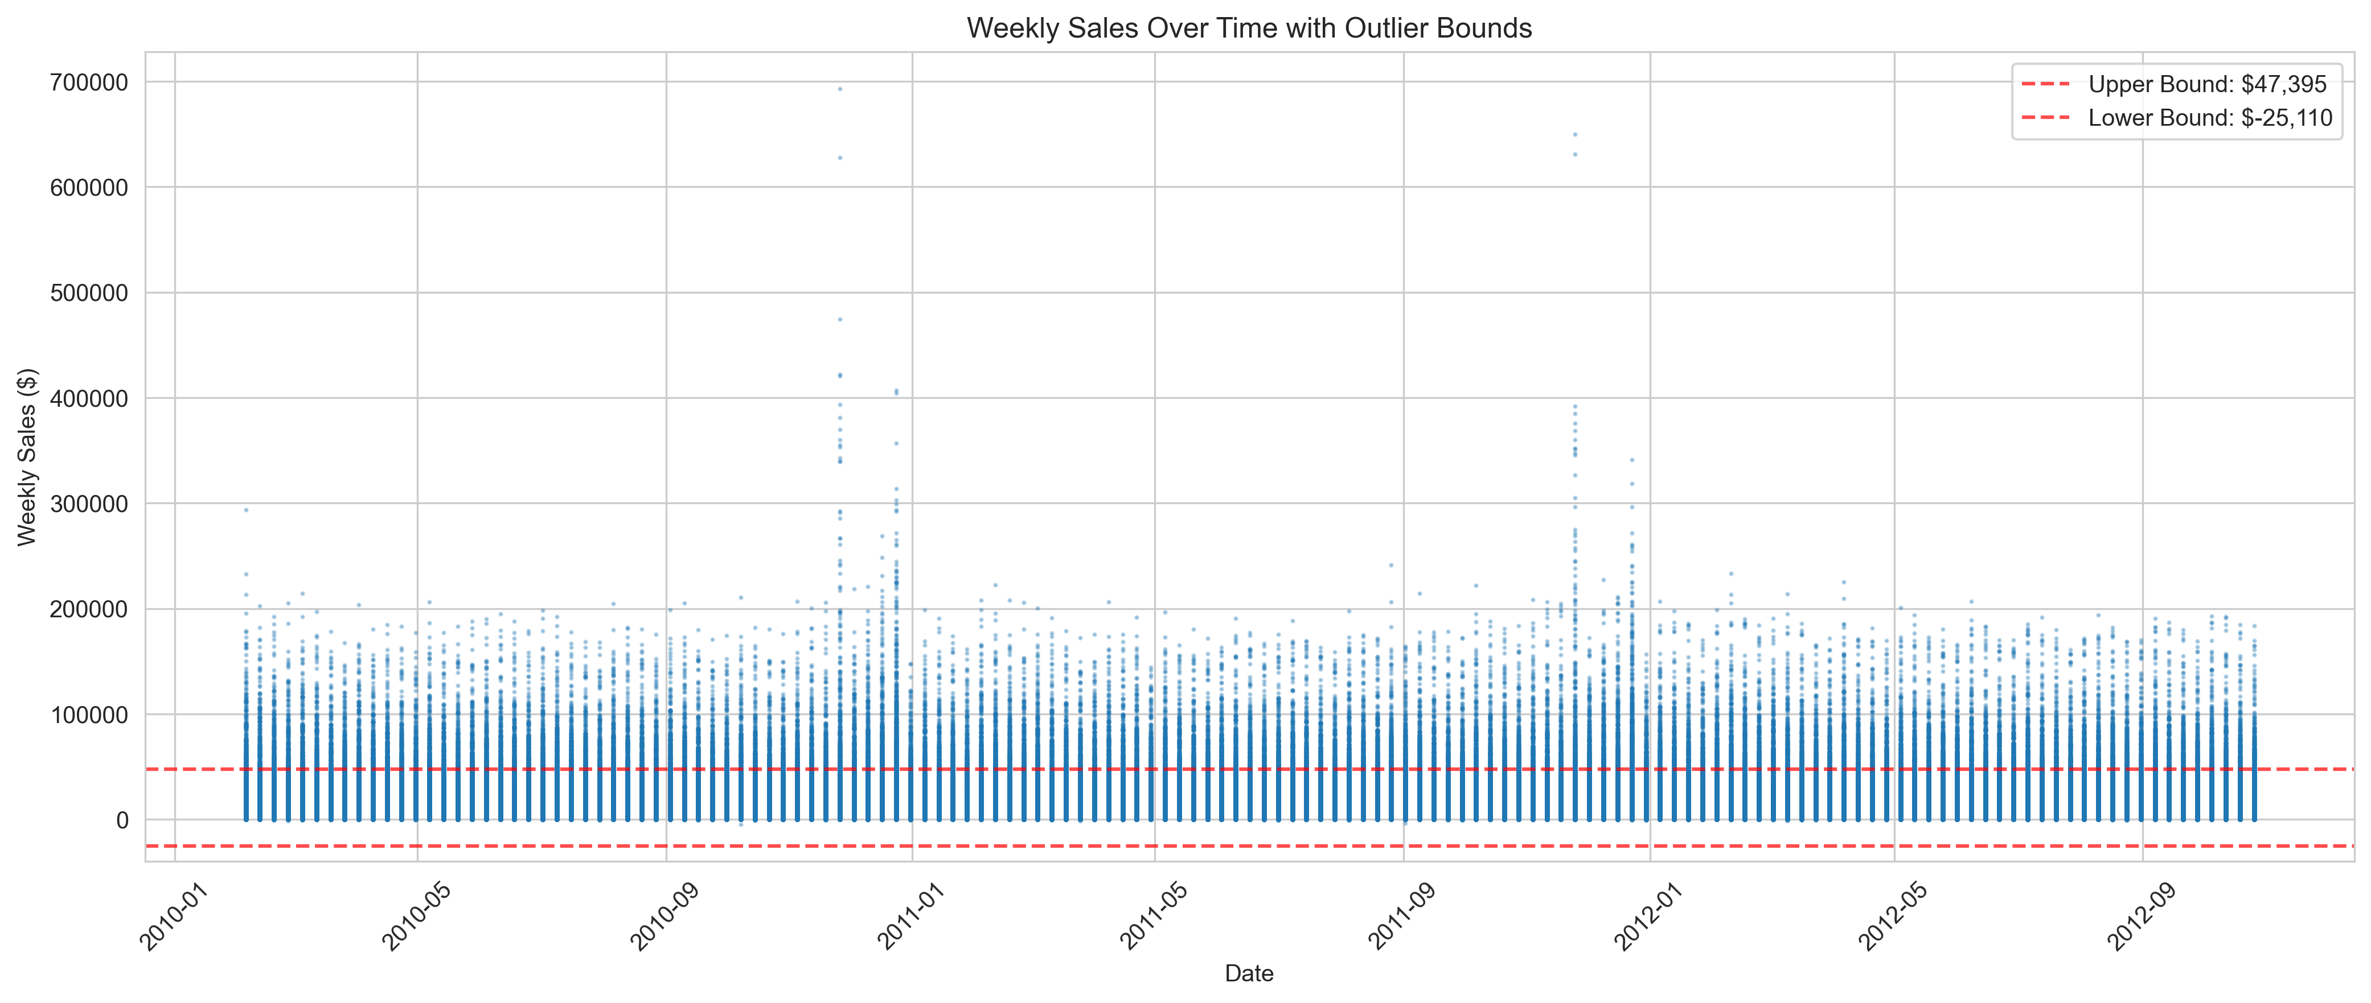
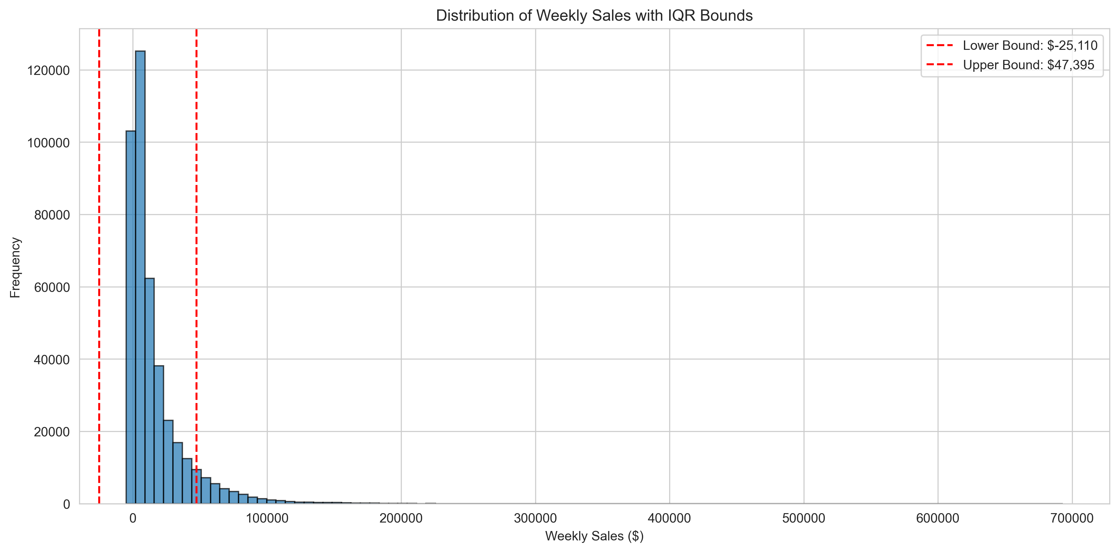
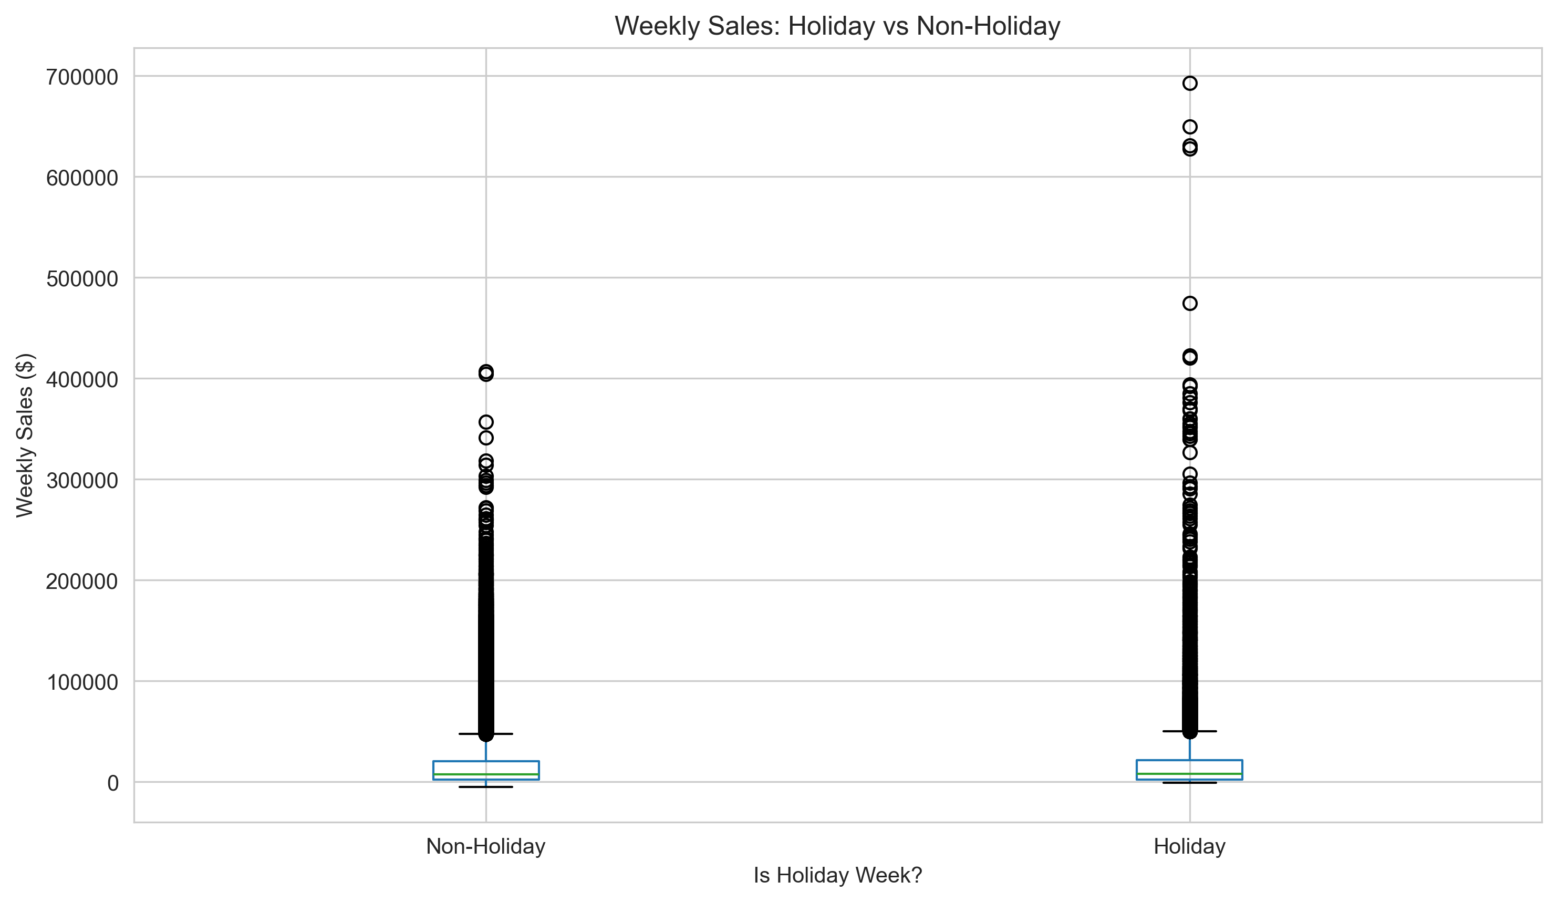
Step 1.3: Outlier Detection
We analyzed outliers using the IQR method and plotted distributions of sales. Although outliers existed, they represented real business events such as holiday spikes. We decided to keep all outliers to avoid removing meaningful patterns.
IQR method: Q3 − Q1 (middle half of the data).

Slide 9
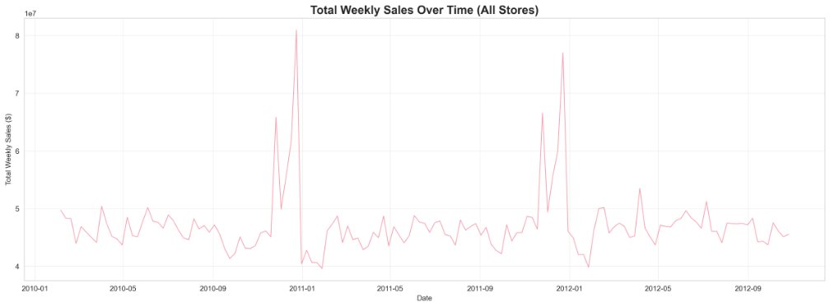
Step 1.4: EDA — Understanding the Data

Slide 10
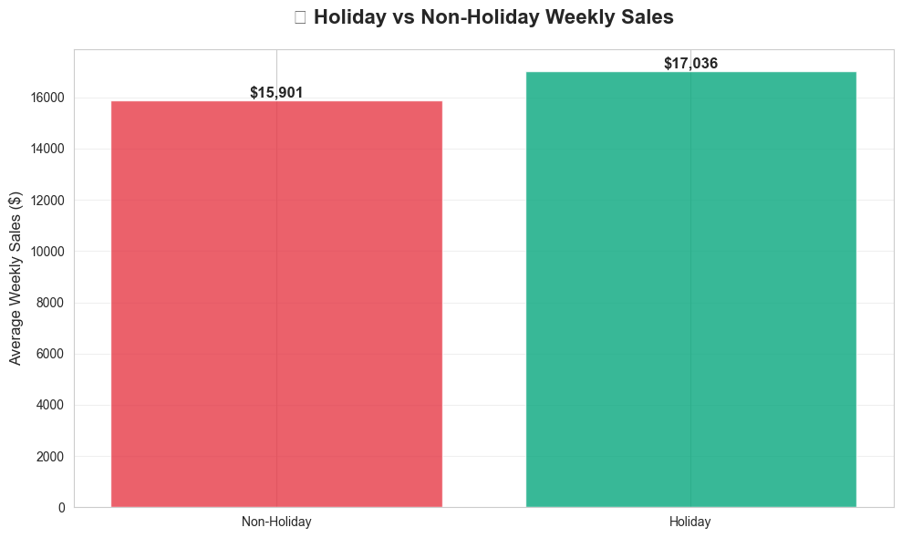
Step 1.4: EDA — Understanding the Data

Slide 11
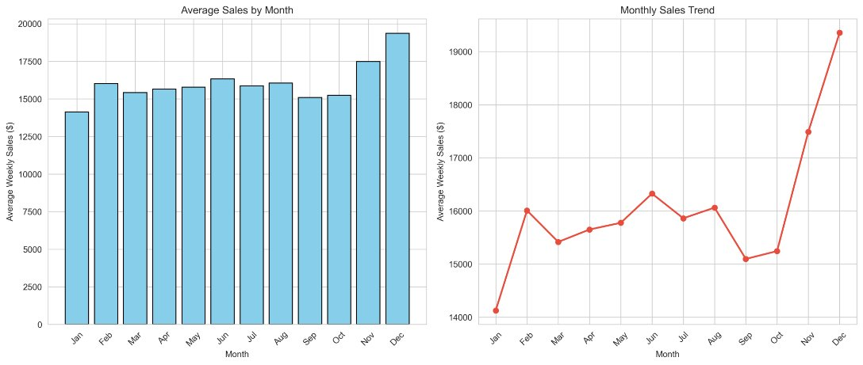
Step 1.4: EDA — Understanding the Data

Slide 12
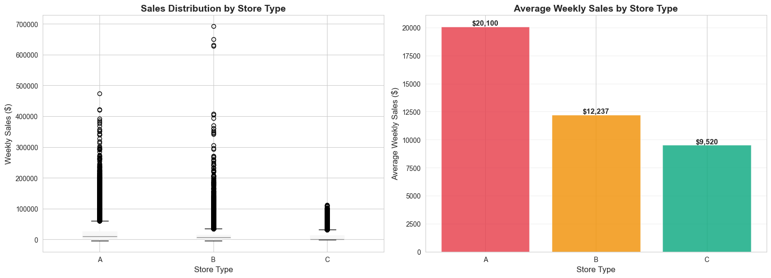
Step 1.4: EDA — Understanding the Data

Slide 13
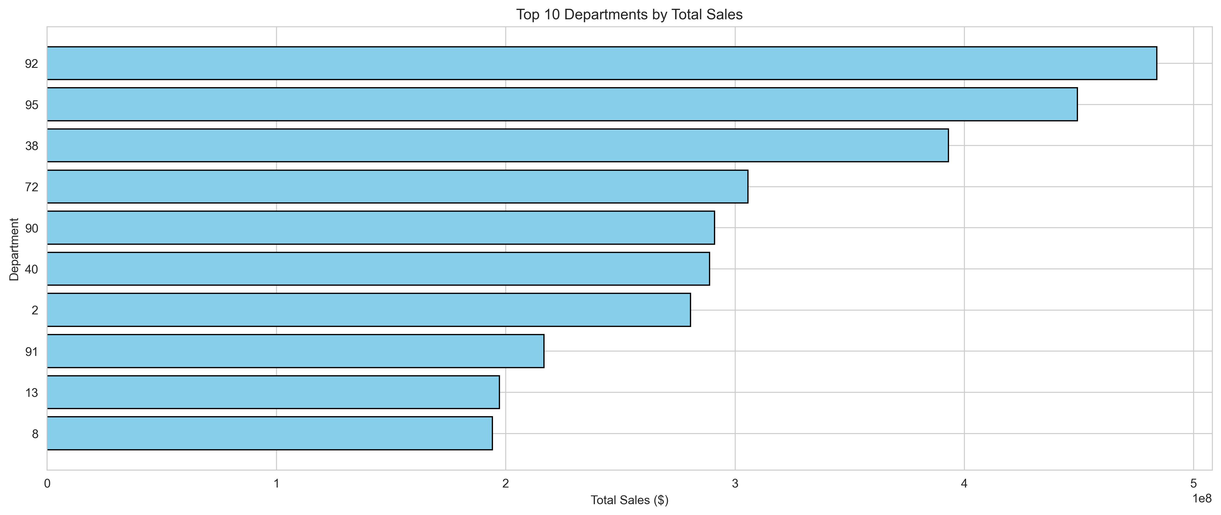
Step 1.4: EDA — Understanding the Data

Slide 14
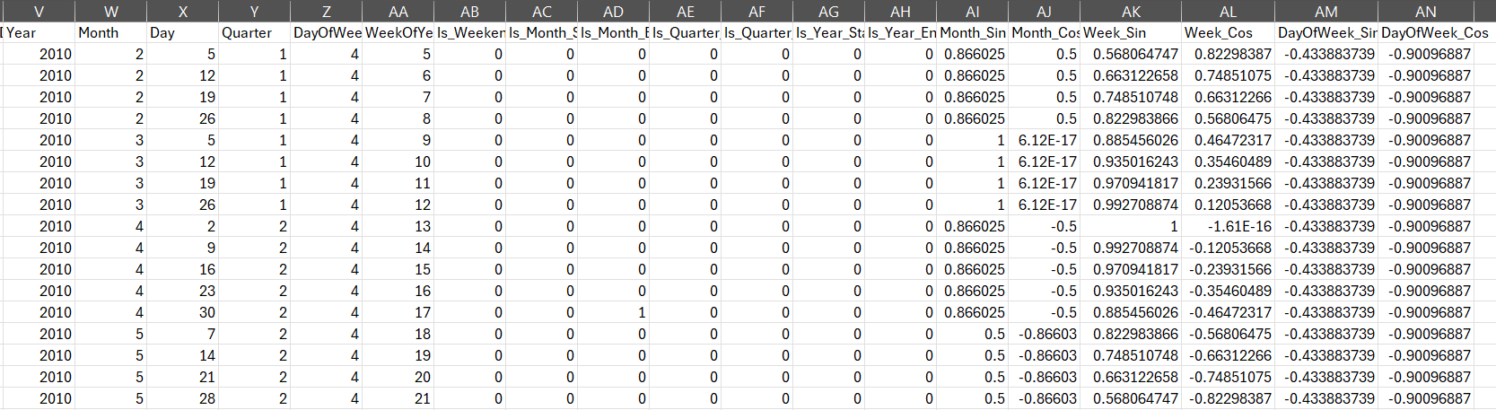
Time Features (Step 1.3.1)
Week_Sin = sin( 2π × week / max_week )
Week_Cos = cos( 2π × week / max_week )

Slide 15
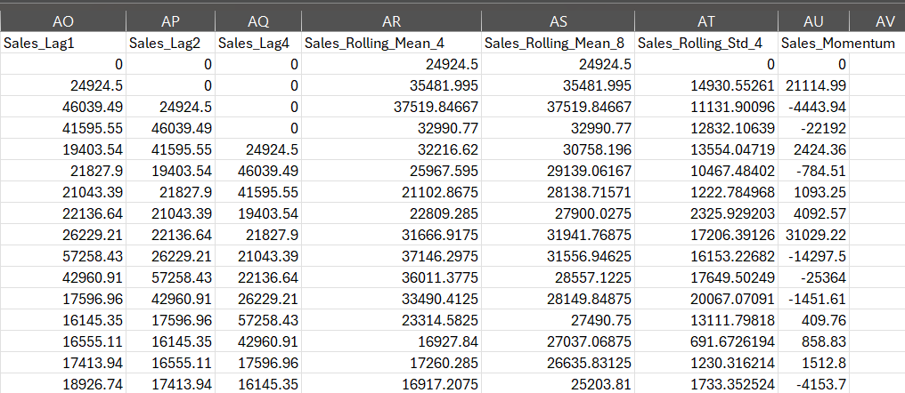
Lag & Rolling Features (Step 1.3.2)
Lag features give the model memory of previous weeks’ sales. Rolling features summarize recent trends and stability in sales.

Slide 16
Lag & Rolling Features (Step 1.3.2)
Our target from this is to conclude data that will help the prediction model
Lag = past value
Feature | Meaning
Sales_Lag1 | sales last week
Sales_Lag2 | sales 2 weeks ago
Sales_Lag4 | sales 4 weeks ago
Rolling = average over several weeks
Feature | Meaning
Sales_Rolling_Mean_4 | average sales of last 4 weeks
Sales_Rolling_Mean_8 | average sales of last 8 weeks
Sales_Rolling_Std_4 | how much sales vary in last 4 weeks
Sales_Momentum | is sales going up or down

Slide 17

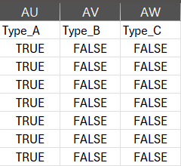
Categorical Encoding (Step 1.3.3)
Actually , this part was in the row data, but it was represented using True/False
Store types were transformed using one-hot encoding. This allows the model to learn differences between small, medium, and large stores.

Slide 18
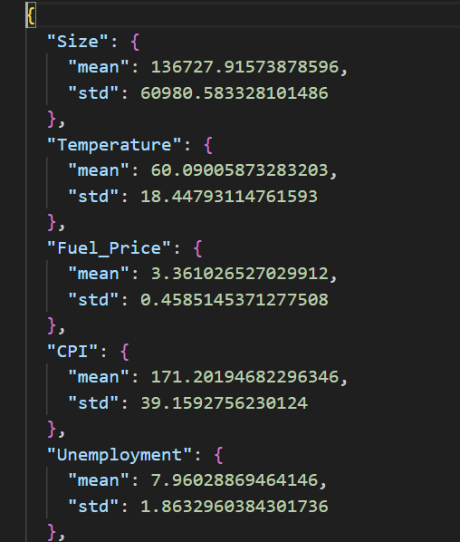
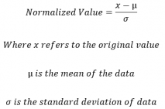
Feature Normalization (Step 1.3.4)
We standardized 17 numeric features using z-score normalization. To avoid data leakage, we saved normalization parameters separately for consistent use during inference.
Why: to not make the model think one value is more important
than another.
Feature | Original Value | After Normalization
Weekly_Sales | 24,924 | -0.70
Temperature | 12.5 | -1.17
CPI | 211.3 | 1.02
Fuel_Price | 3.10 | -1.72

Slide 19
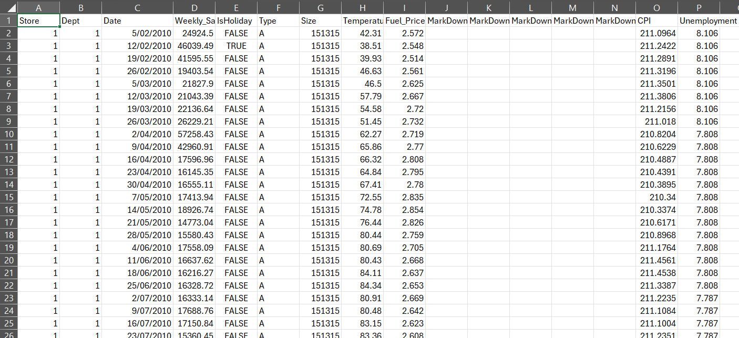
Final Dataset Summary
At the end of Stage 1, both training and test data were fully cleaned, transformed, and enriched. This dataset is now suitable for machine learning and deep learning forecasting models.
train.csv Before

Slide 20
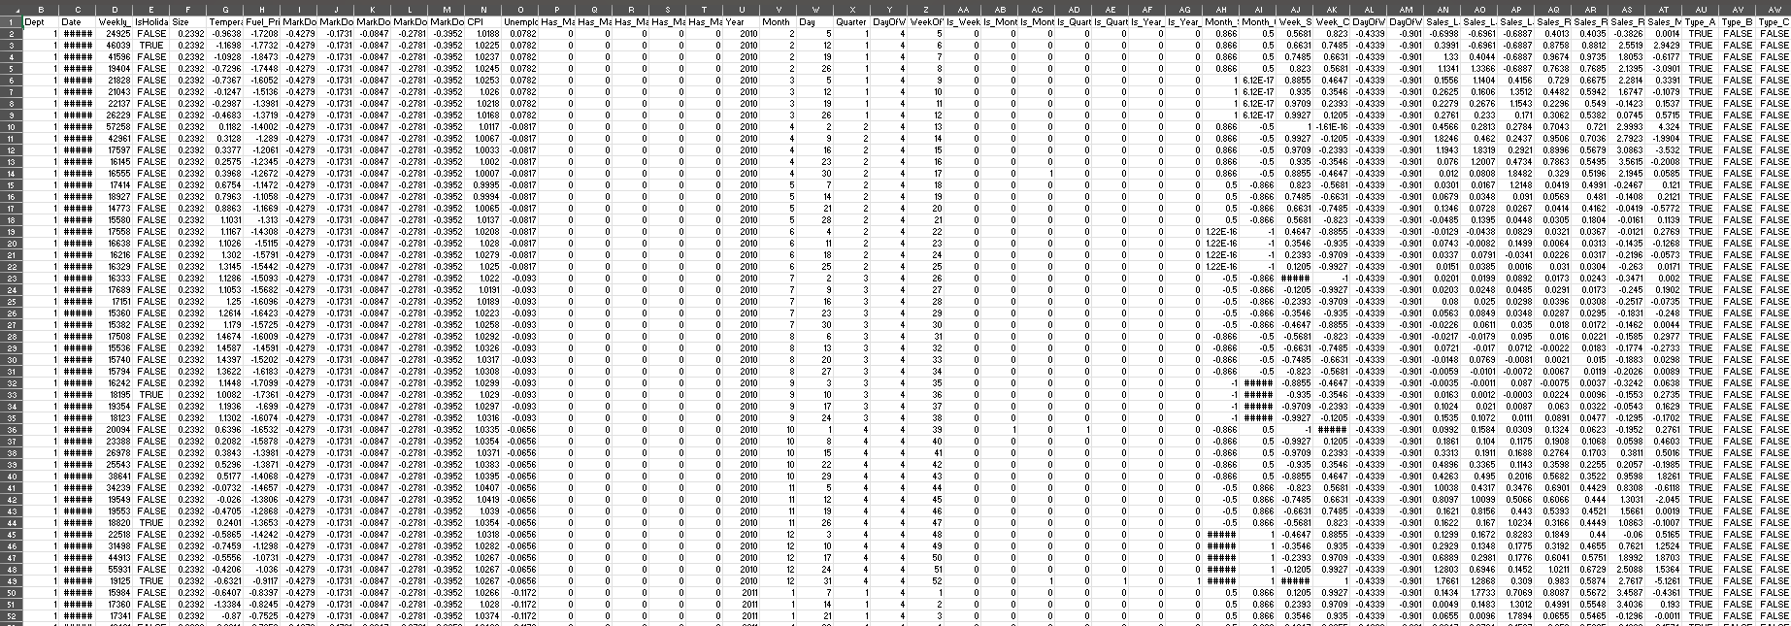
Final Dataset Summary
train_final.csv After

Slide 21
Milestone 2: Advanced Data Analysis & Feature Engineering
In Milestone 2 we performed advanced time-series analysis and expanded our feature set to improve forecasting accuracy.

Slide 22
Stage 2 Overview
Advanced Analysis
Enhanced Feature Engineering
Advanced Visualizations

Slide 23
Task 2.1: Advanced Data Analysis (overview)
Task 2.1 performed time-series decomposition, stationarity testing, correlation analysis, and quantified holiday effects.
Time Series Decomposition (Trend, Seasonality, Residual)
ADF Stationarity Test
Correlation Analysis (heatmap + top predictors)
Holiday Impact Analysis

Slide 24
Time Series Decomposition (Trend, Seasonality, Residual)
First, we aggregated the data into a single weekly time series by summing weekly sales across all stores and departments, and sorted it by date.
weekly_sales = train.groupby('Date')['Weekly_Sales'].sum()
Original
Trend
Seasonality
Residual
Then, we extracted the trend using a 52-week rolling mean to capture the long-term sales movement.
removed the trend from the original series to isolate seasonal effects.
Then calculated seasonality by averaging the detrended values for each week of the year, capturing repeating annual patterns.
residual = detrended - seasonality
trend =
weekly_sales.rolling(window=52, center=True).mean()

Slide 25
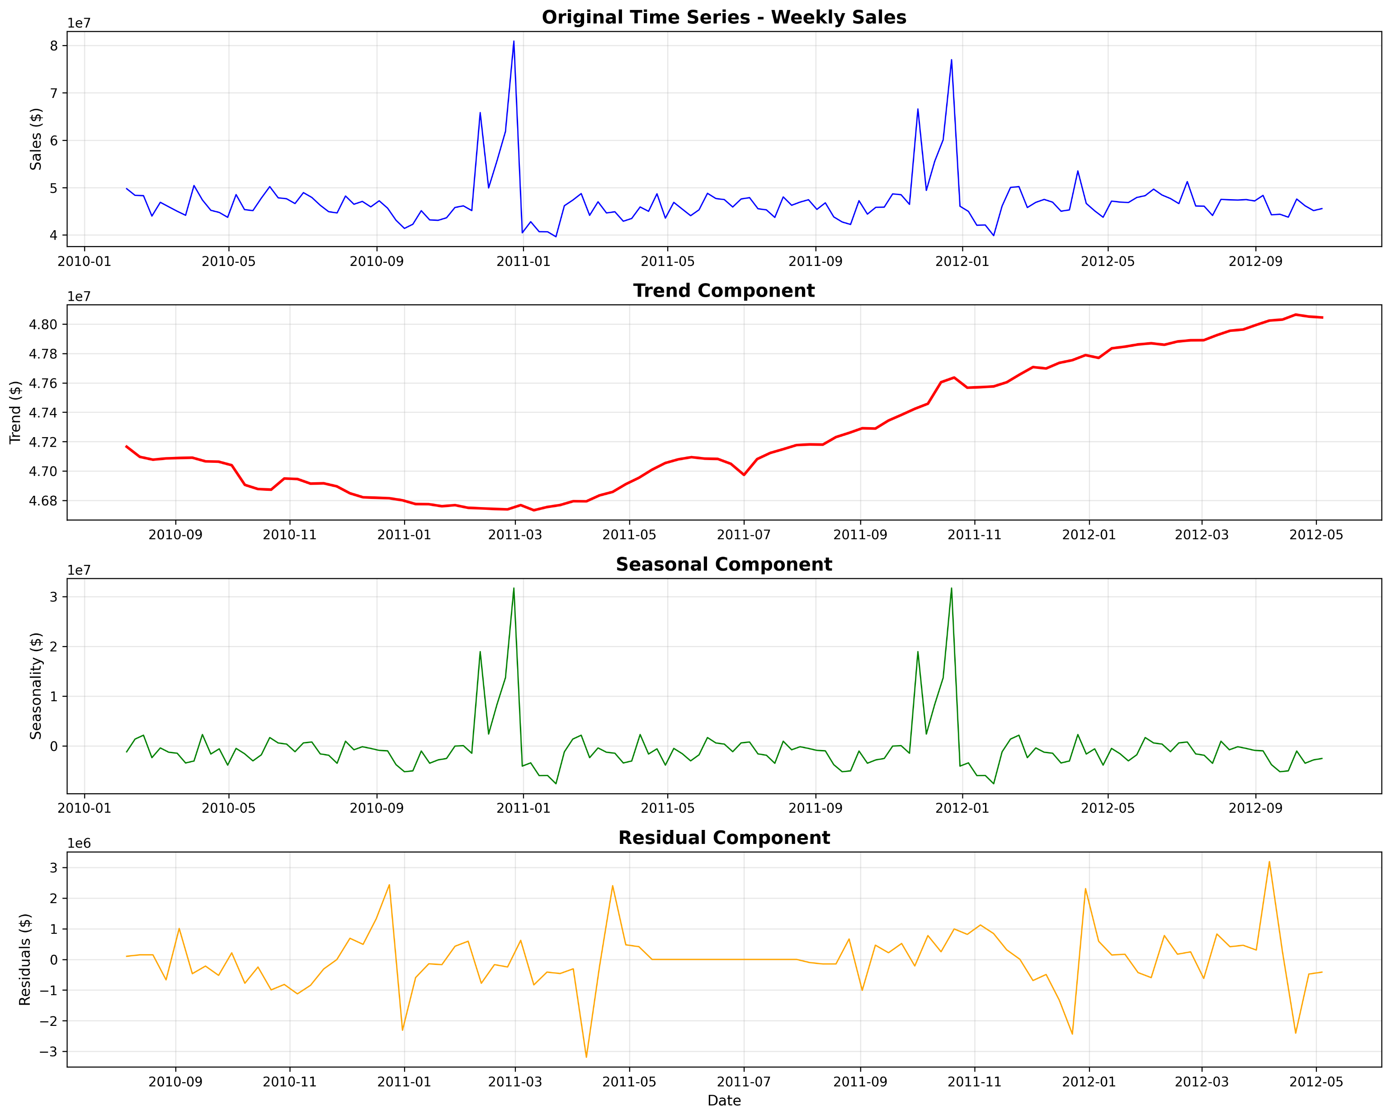
Task 2.1: Advanced Data Analysis (overview) (trend / seasonality / residuals)

Slide 26
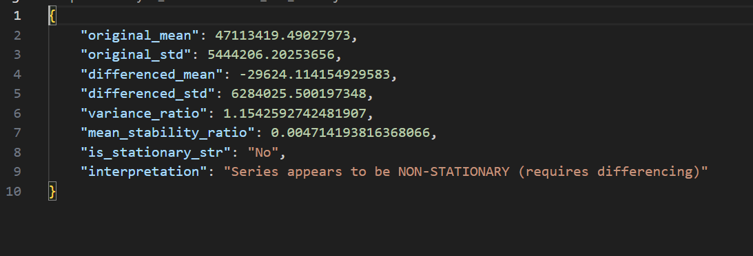
Stationarity (ADF results)
ADF tests show the sales series is non-stationary (p-value > 0.05), so differencing is required for ARIMA-type models to make the series stationary.
ADF basically answers: “Does this data have a trend or not?”
The p-value tells you if the ADF test result is significant or not.
p-value > 0.05 → the sales data is non-stationary.

Slide 27
What Is ARIMA (as we are preparing for forecasting)
A = Auto
R = Regressive (uses past values)
I = Integrated (this means differencing to remove trends)
MA = Moving Average (uses past errors)
And these models require the data to be stationary.
So if ADF shows non-stationarity (p > 0.05), we must use: Differencing Example: y_diff = y(t) - y(t-1)
This removes the trend and makes the series stationary.

Slide 28
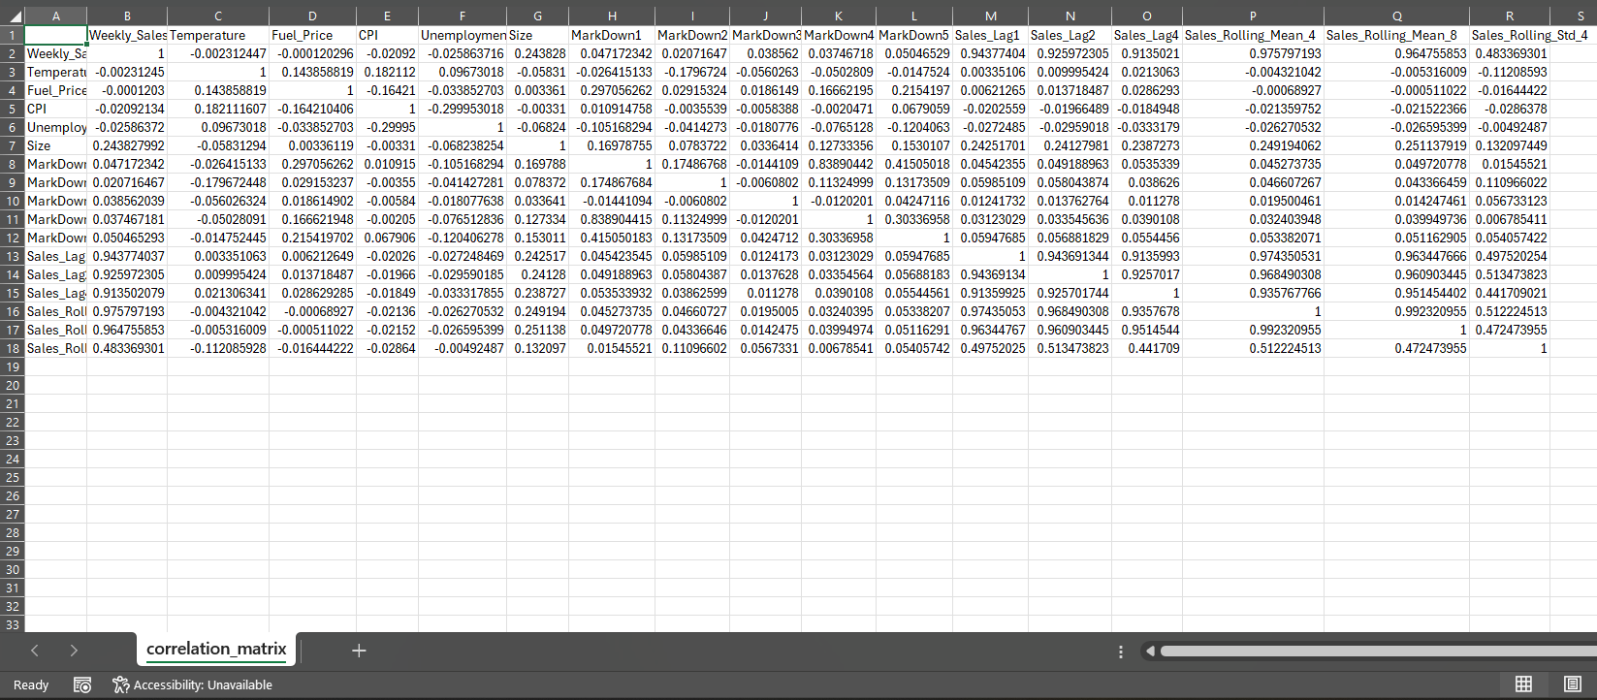
Correlation Analysis (heatmap)
Correlation analysis confirms that lag and rolling features dominate; the heatmap highlights which engineered features align most strongly with Weekly_Sales.

Slide 29
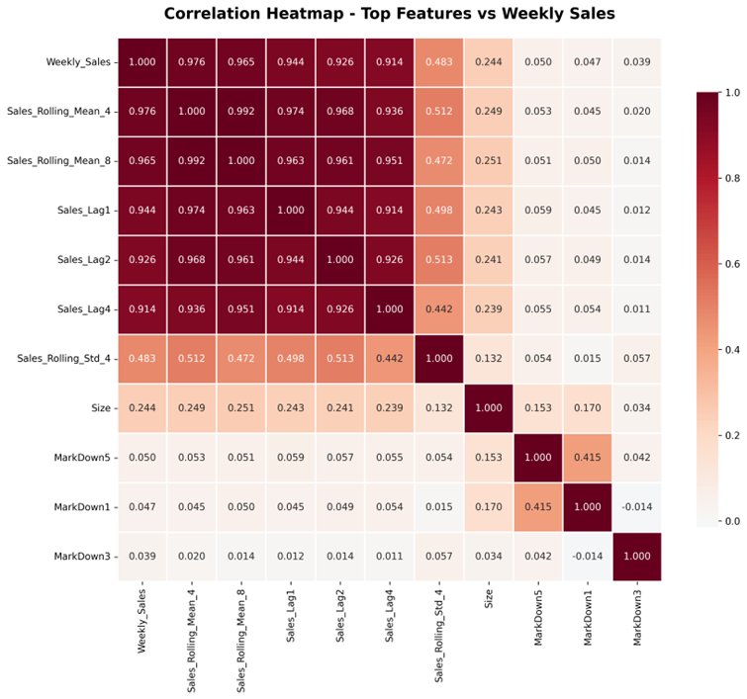

Slide 30
Top Correlated Features (numbers)
The 4-week rolling average has the strongest correlation with weekly sales. This tells us that recent short-term trends are the most powerful predictor of next week’s sales.
The 8-week rolling average is also extremely strong. This means the model benefits from understanding medium-term sales patterns, not just the last few weeks.
Recent past sales , especially 1-week, 2-week, and 4-week lags , all show very strong correlations, confirming that weekly sales strongly depend on short-term history and recurring monthly patterns.

Slide 31
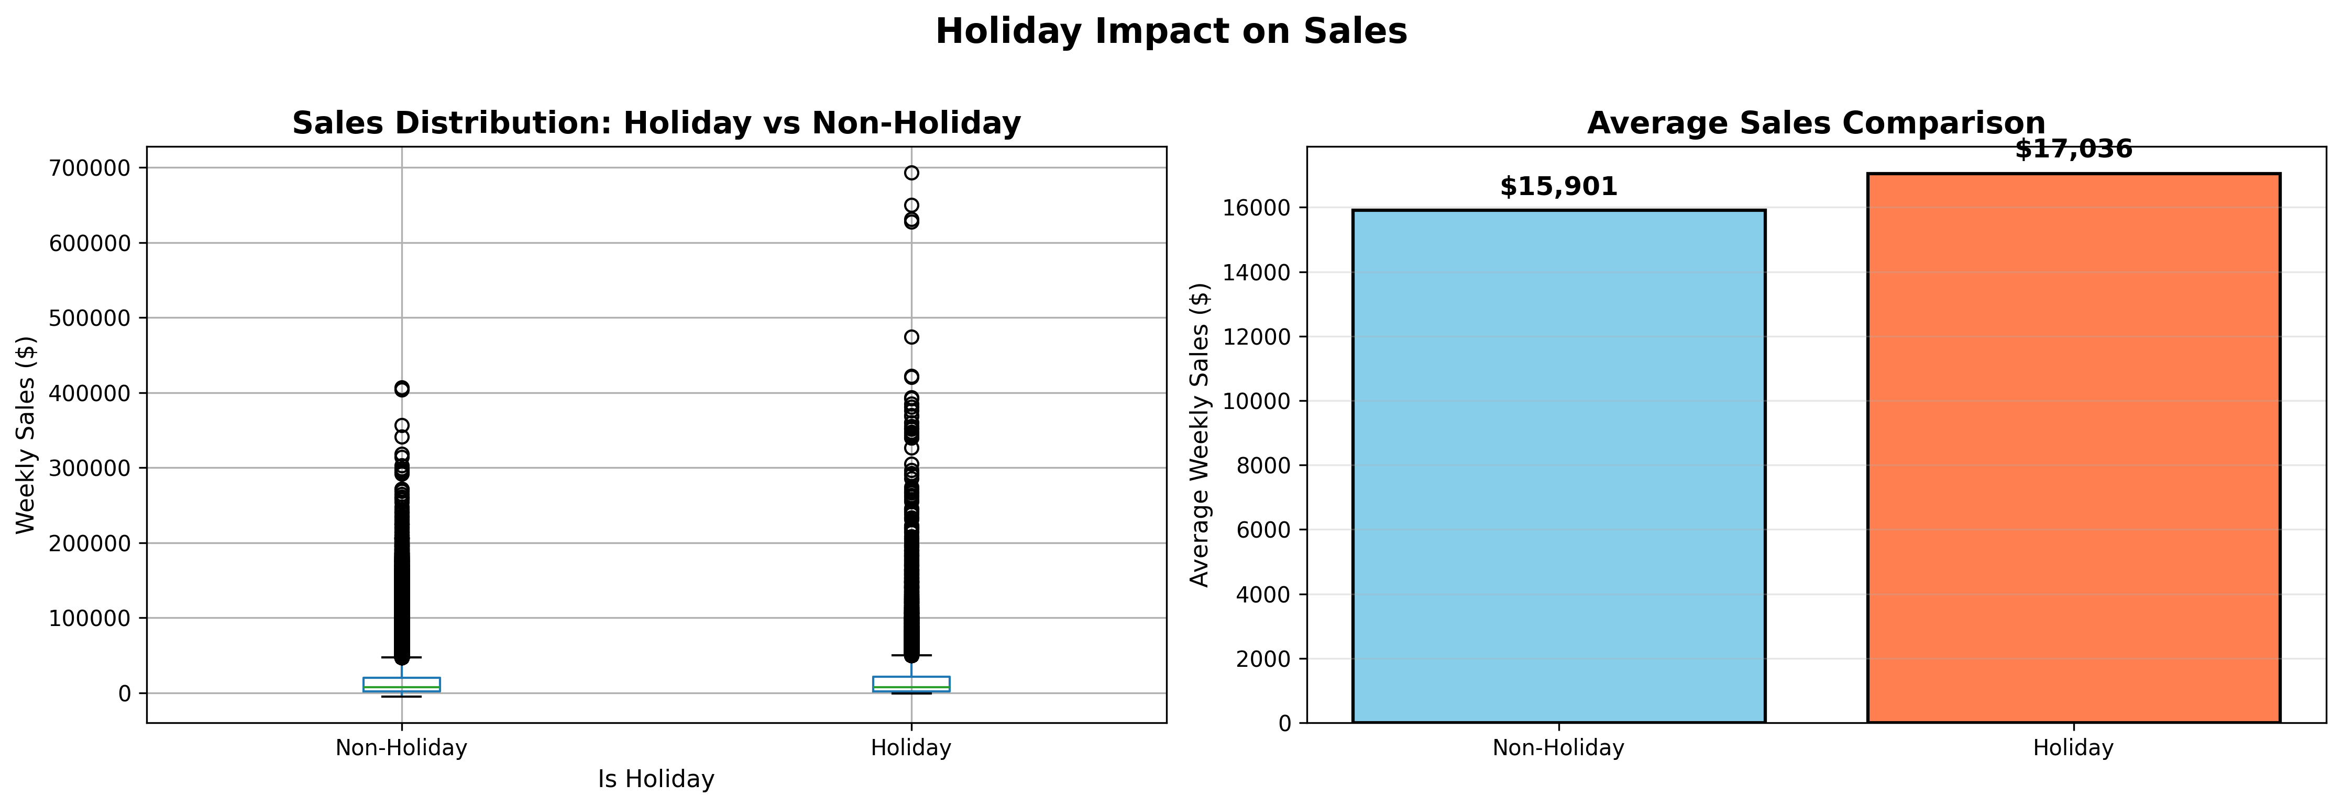
Holiday Impact Analysis
Holidays increase average sales by +7.13% and increase volatility by +21.9%. We therefore created specific holiday-season and 'days-to-holiday' features.

Slide 32
Task 2.2: Enhanced Feature Engineering (overview)
We added 42 new advanced features across 6 categories:
1- Advanced Rolling Statistics EMAs, rolling min/max, ranges, trends, coefficient of variation, acceleration.
2- Seasonal & Holiday Features Holiday season flags, back-to-school, Super Bowl, days until Thanksgiving/Christmas, seasonal dummies.
3- Store Performance Features Store averages, department averages, store-dept combos, deviations from averages.
4- Promotional Features Total markdowns, number of active promotions, promo intensity, rolling promo averages.
5- Economic Interaction Features CPI × unemployment, holiday temperature, fuel price × unemployment, purchasing power.
6- Time-Based Aggregations Monthly and quarterly average sales, total sales, YoY store growth.

Slide 33
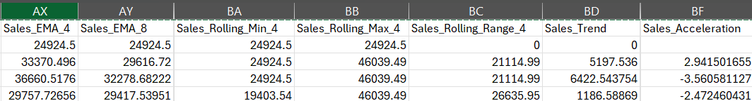
Example: Advanced Rolling Stats (EMAs & Acceleration)
– EMA → recent trend – Min/Max/Range → volatility – Trend → short-term direction – Acceleration → how fast trend changes
EMAs give weighted recent trends, range/min/max capture extremes, and acceleration quantifies the speed of change — all crucial for short-term forecasting.

Slide 34
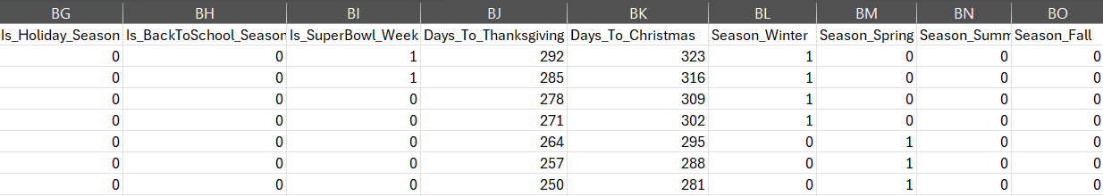
Example: Seasonal & Holiday Features
These features explicitly encode holiday timing and season boundaries so models can react to predictable calendar-driven spikes.

Slide 35
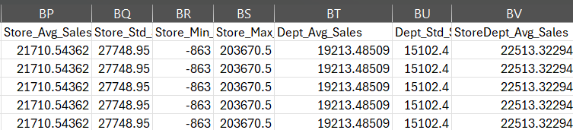
Example: Store/Dept Aggregates & Deviations
Store | Dept | Weekly_Sales | Store_Avg_Sales | Dept_Avg_Sales | StoreDept_Avg_Sales
1 | 1 | 24924.5 | 21710.5 | 19213.5 | 22513.3
The dataset contains many stores and many departments. So we created summary features that describe how each store, each department, and each store–department combination usually performs. These help the model understand the baseline sales and whether a particular week is above or below normal.

Slide 36
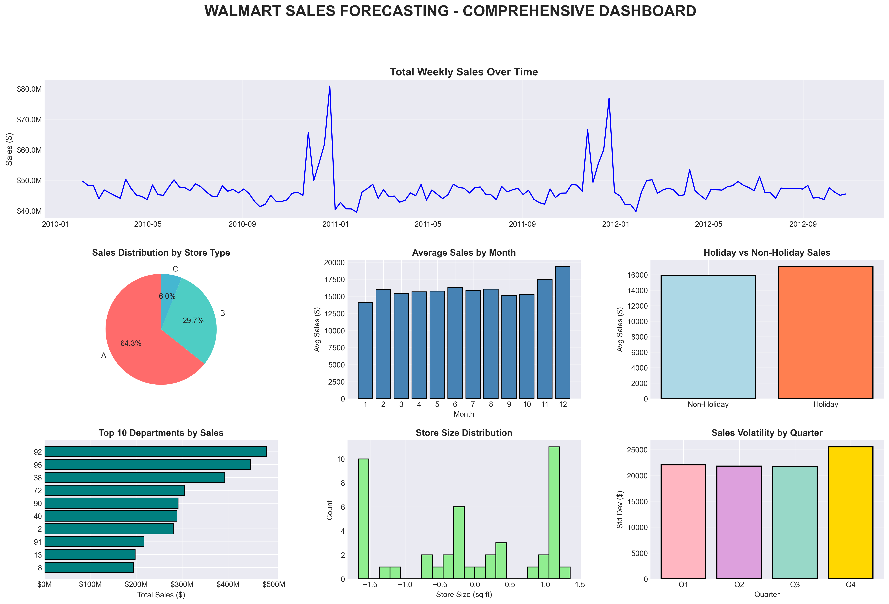
Task 2.3: Advanced Visualizations (dashboard)
We produced a 7-panel dashboard and multiple plots that helped validate feature choices and communicated the patterns to stakeholders.

Slide 37
Task 2.3: Final dataset summary
train_enhanced.csv before

Slide 38
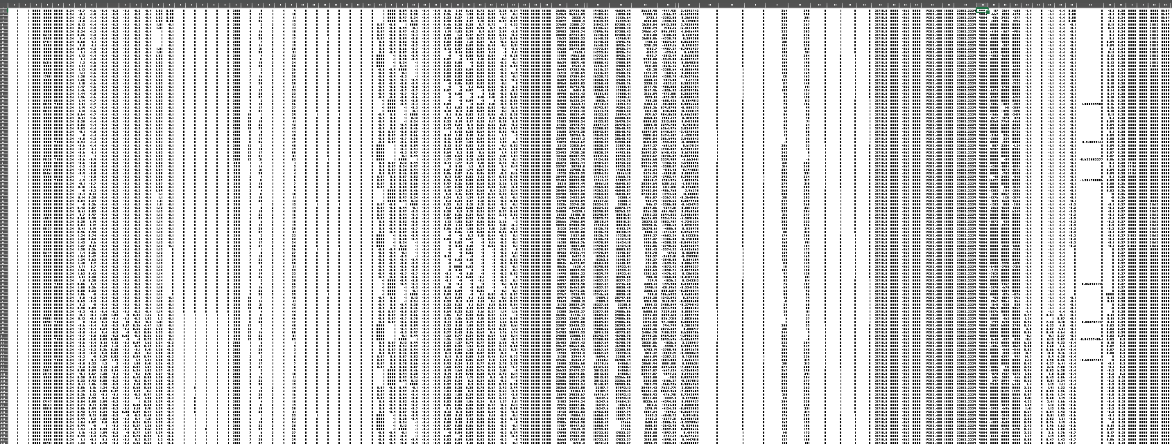
train_enhanced.csv After
(421,570 × 91)

Slide 39
Milestone 3: Machine learning model building
In this Milestone, we have chosen 3 types of models and separated the features into 5 stages. Each stage contains a related group of features to make a comparison and choose the best model and the best stage of features.
Models used → Random-Forest, XGBoost, lightGBM
Stages used → Stage 1 (Critical) → Stage 2 (+Promotions) → Stage 3 (+Temporal) → Stage 4 (+External) → Stage 5 (+Advanced)

Slide 40
Milestone 3 Overview
Models Building
Models Training & Testing
Accuracy Evaluation
Best Model Selection

Slide 41
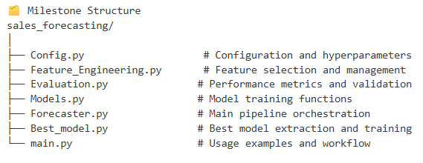
Milestone Structure & Files Implemented

Slide 42
Progressive Feature Strategy
Stages:
1) Critical → Historical patterns, Time features, Store type, Holiday
2) With Promotions → capture weekly and daily patterns
3) With Temporal → Test if promotional information improves predictions
4) With External → Test if external factors improve predictions
5) Full → Advanced features capturing sales dynamics

Slide 43
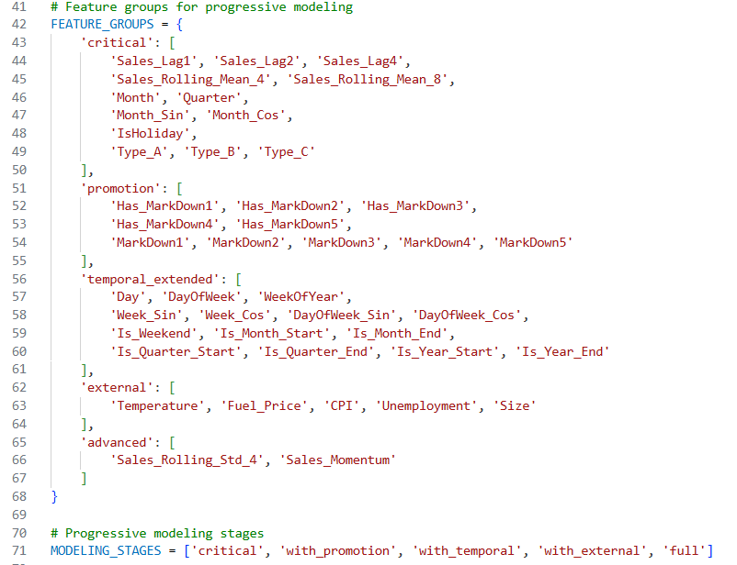
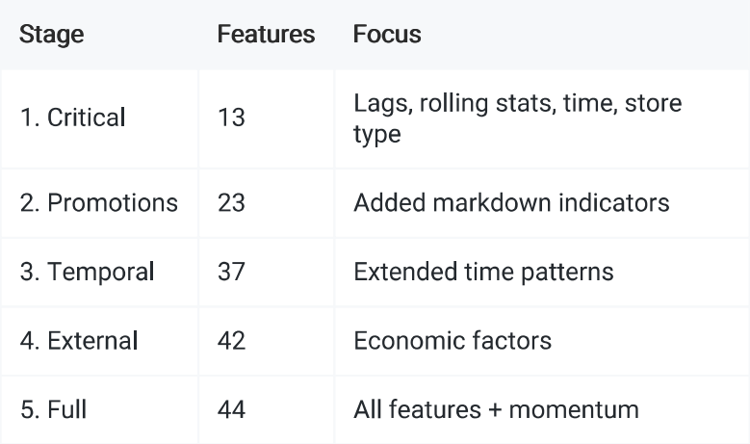
Progressive Feature Strategy
Previous models were trained through 5 stages with increasing complexity →

Slide 44
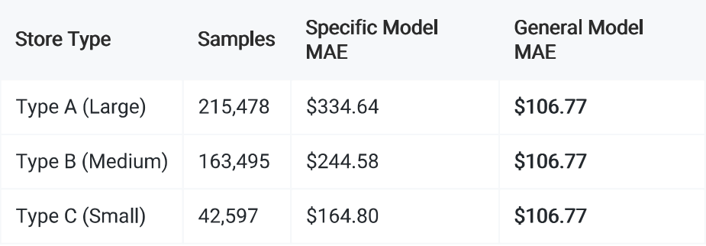
Advanced Store Type Models
Also added more specific Train separate models for each store type (A, B, C).
Type A Dominates (over half the data)
Type B Substantial (near 40 %)
Type C Smallest (only 10 %)

Slide 45
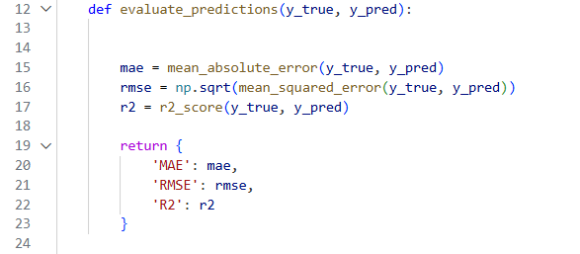
Models Evaluation & Comparison
Evaluation Metrices used:
MAE → Measures average prediction error
RMSE → penalizes large errors more heavily
R2 score → explains how well the model fits the data

Slide 46
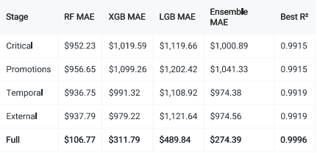
Models Evaluation & Comparison
It is obvious in the figure that all the models show massive improvement with the last feature stage (Full) stage.
According to this comparison, we chose the Random-Forest Model in the stage (Full) as the best model ready for deployment.

Slide 47
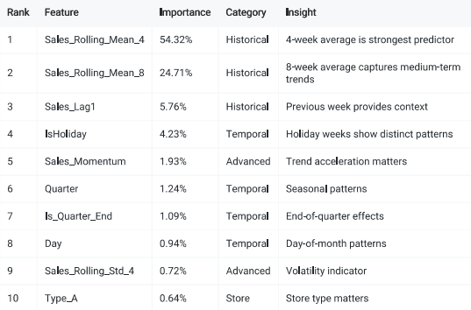
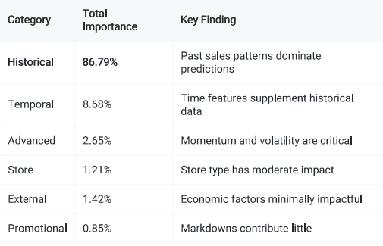
Feature Importance Analysis
Top 10 Features for Random-Forest Model.
Business Implications:
Rolling Averages (79% combined)
Holiday Impact (4.23%)
Promotional Limitation (<1%)

Slide 48
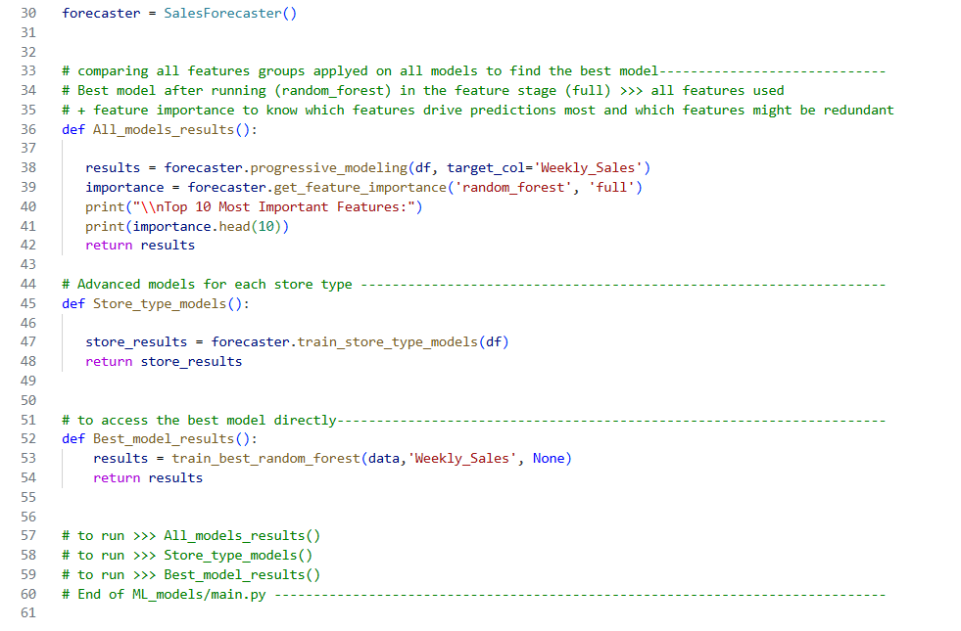
Models Pipeline
Eventually, we made a Pipeline for running all the steps that contain:
All_models_results() containing features importance
Store_type_models()
Best_model_results()

Slide 49
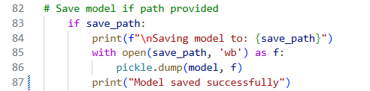
Model Saving
Implemented to save the best model if the path is provided (Optional).

Slide 50
Stage 4: MLOps, Deployment & Monitoring

Slide 51
Stage Overview
Built an end‑to‑end ML system for sales forecasting
Random Forest model achieving 99.96% R² accuracy
Full MLOps pipeline: API, dashboard, monitoring, Docker, MLflow

Slide 52
Prediction Engine
121MB Random Forest model with 44 engineered features
Integrated historical data (50K+ records)
Dynamic path resolution for stable imports
Graceful handling of missing values and edge cases

Slide 53
REST API (FastAPI)
Endpoints: health, predict, batch, multi‑week, model info
Automatic Swagger UI documentation
Input validation with Pydantic
Production startup via uvicorn runner

Slide 54
Dashboard (Streamlit)
4 pages: Prediction, Performance, Monitoring, Model Info
Interactive visualizations with Plotly
Forecasting up to 52 weeks
Business‑friendly interface

Slide 55
MLOps & Tracking
MLflow tracking with 50+ experiments
Versioned models & registry
Automated experiment runner
Comprehensive training logs and metrics

Slide 56
Monitoring System
Latency & error monitoring
Drift detection (KS test, distribution tracking)
Automated alerts and logs

Slide 57
Docker Deployment
Multi‑service architecture: API, Dashboard, MLflow
Optimized Dockerfile with caching & retries
docker-compose for orchestration
Production setup with Nginx, SSL, load balancing

Slide 58
Git LFS & Model Storage
121MB model stored via Git LFS
Efficient cloning and deployment
Version control for large binary artifacts

Slide 59
Cloud Deployment
Streamlit Cloud for free deployment
GitHub auto‑deployments
Fixed dependency conflicts and watcher issues
Live URL with HTTPS

Slide 60
Testing & Validation
Unit, integration, and end‑to‑end tests
Automated verification scripts
Feature engineering validation

Slide 61
Final Architecture
API + Dashboard + Predictor + Model + MLOps stack
Real‑time predictions with monitoring
Separation of services for scalability

Slide 62
Achievements
2000+ lines of production code
5500+ lines of documentation
Complete production‑ready ML system
Successfully deployed live dashboard

